Slide 1
IMS / DB

Slide 2
WHAT IS IMS/DB ?
IMS/DB stands for Information Management System/Data Base
IMS is an IBM’s product
IMS is an "HIERARCHICAL" database.
IMS/DB is also referred to as Navigational Database, because, the application programs have to take care of searching and traversing the database. This is not the case with DB2.

Slide 3
Types of Databases
Relational
Example: DB2
2) Network
Example: IDMS
3) Hierarchial
Example: IMS/DB

Slide 4
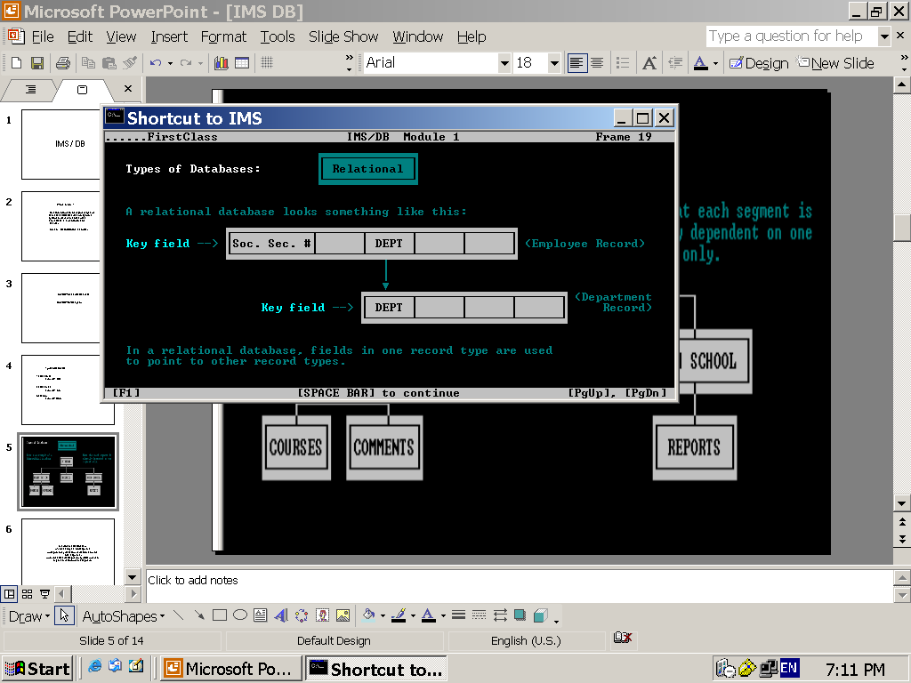

Slide 5
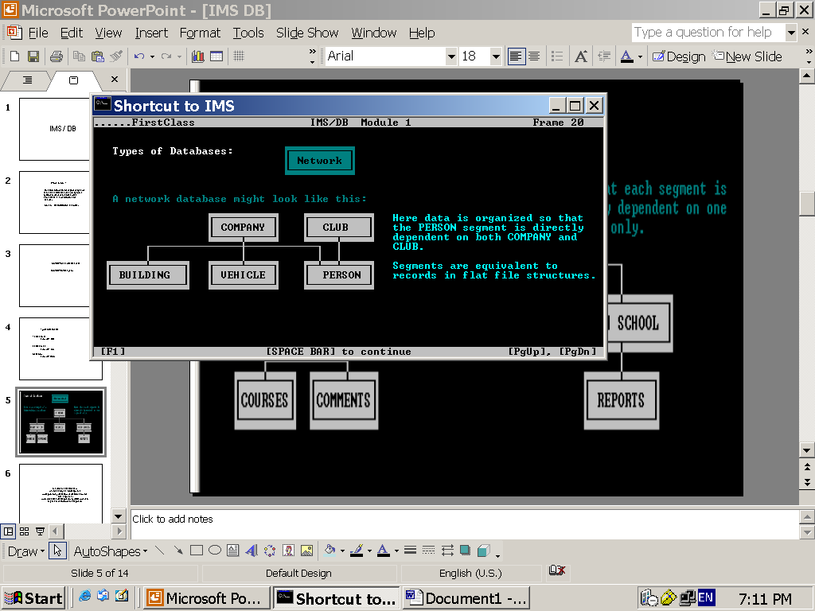

Slide 6
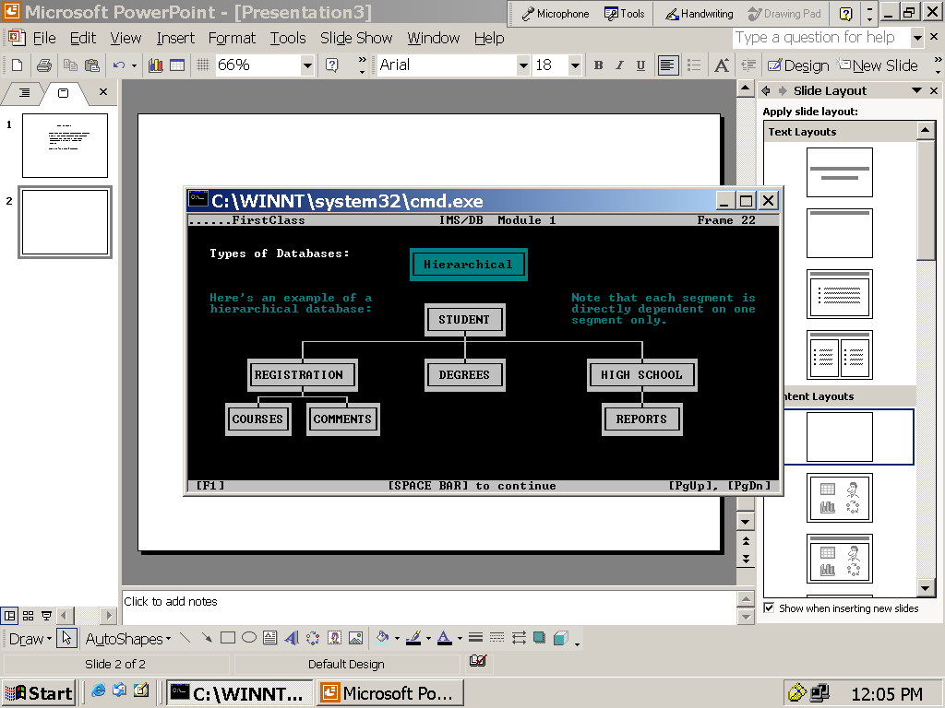

Slide 7
How the relation is identified?
RDBMS
Primary Key – Foreign key relationship
Hierarchial DB
Parent, Child relationship

Slide 8
What are they?
SEGMENT
FIELD
ROOT SEGMENT
PARENT SEGMENT
CHILD SEGMENT
DEPENDENT SEGMENT
SEGMENT OCCURRENCE
TWINS

Slide 9
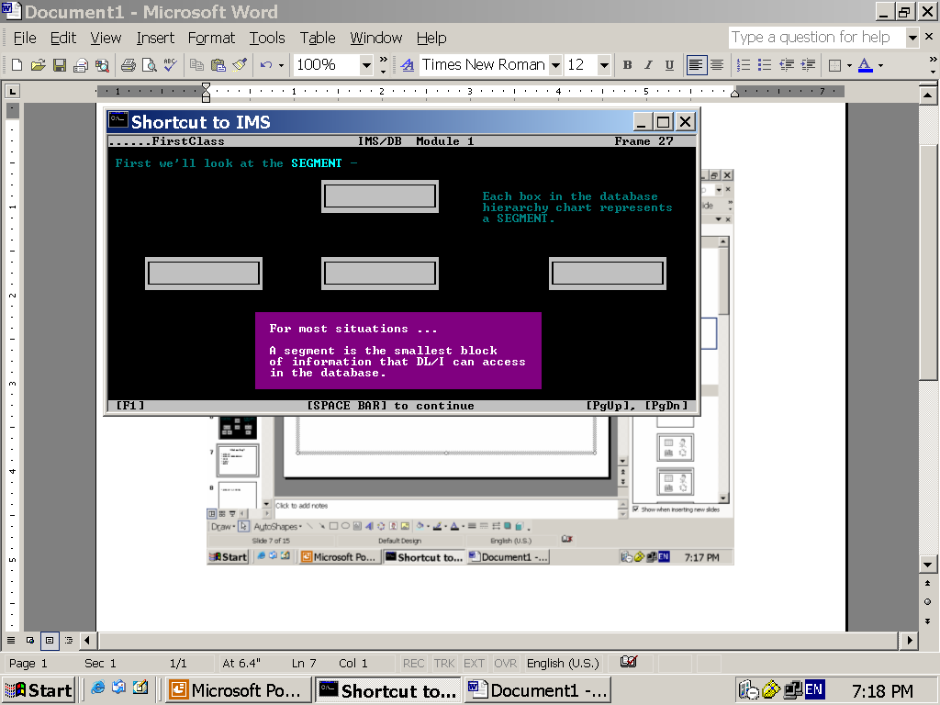

Slide 10
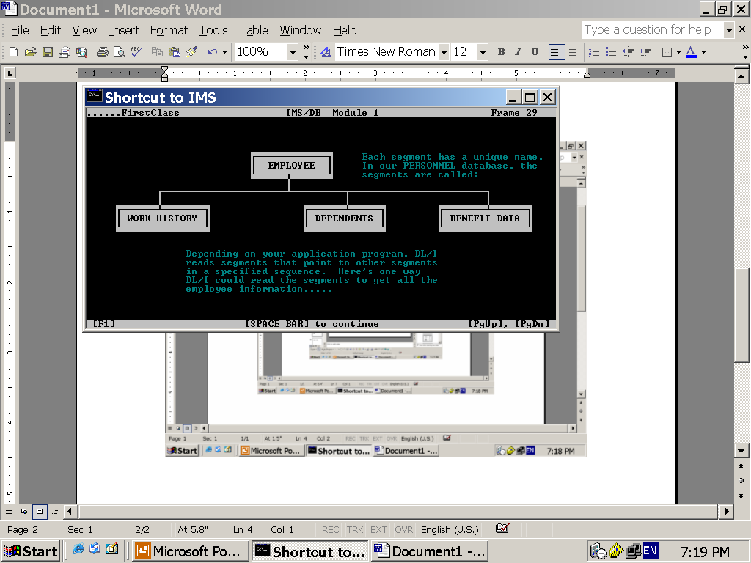

Slide 11
Key concept…!

Slide 12
How this database is accessed?

Slide 13
FIELDS THAT BELONG TO A SEGMENT
FIELD is the smallest unit of information in a database.
EMPLOYEE segment has the following 4 fields:
EMPLOYEE
EMP-ID
EMP-LASTNAME
EMP-FIRSTNAME
EMP-PHONENUM

Slide 14
KEY FIELD
AND
SEARCH FIELD

Slide 15
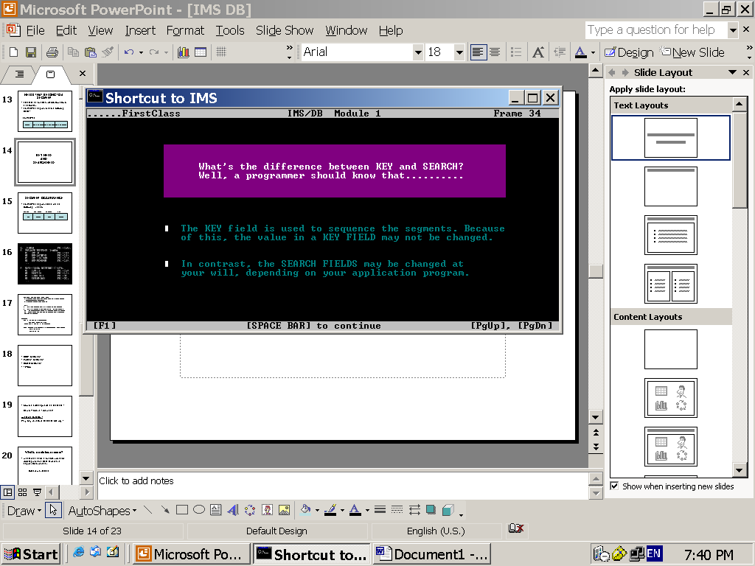

Slide 16
PARENT and
CHILD SEGMENT

Slide 17
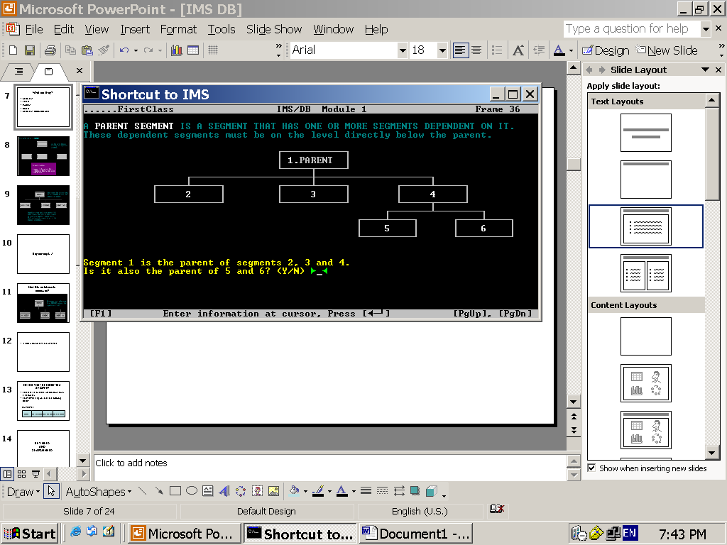

Slide 18
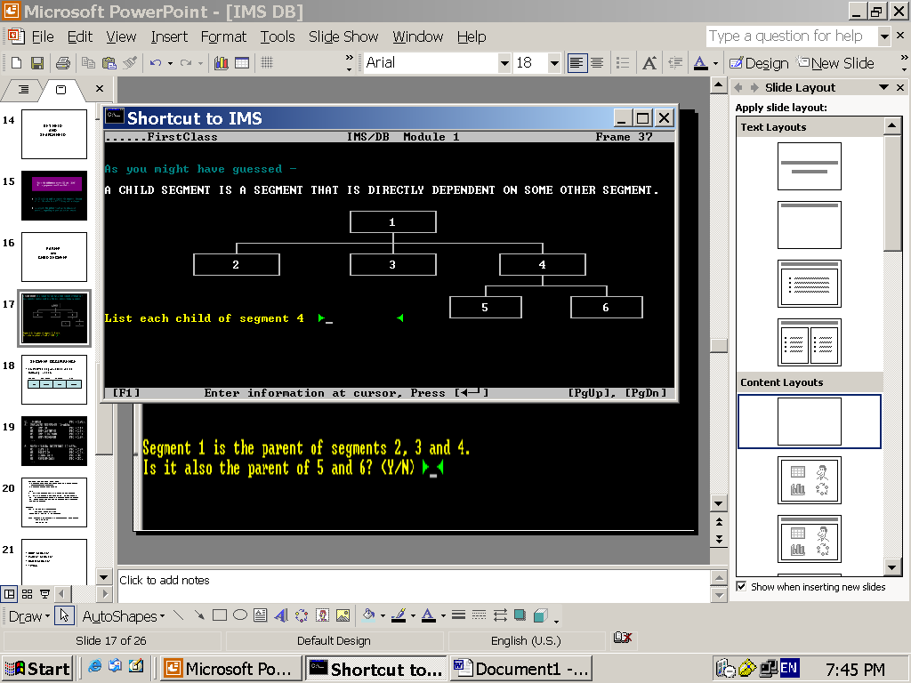

Slide 19
DEPENDENT SEGMENT

Slide 20
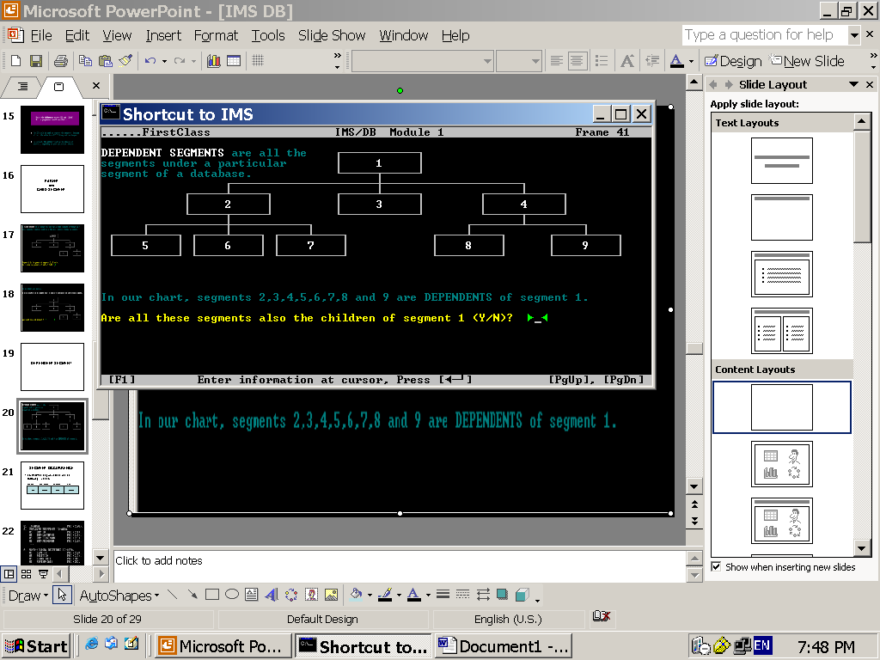

Slide 21
SEGMENT OCCURRENCE
EMPLOYEE segment fields has the following 4 values.
EMP-ID FIRST NAME LASTNAME PHONE
1234
SWAMI
HARI
567899

Slide 22
Remember..!
SEGMENT
and
SEGMENT OCCURRENCE
are used interchangeably..!

Slide 23
TWINS
Two or “MORE” segment occurrences are called TWINS.

Slide 24
DATABASE RECORD

Slide 25
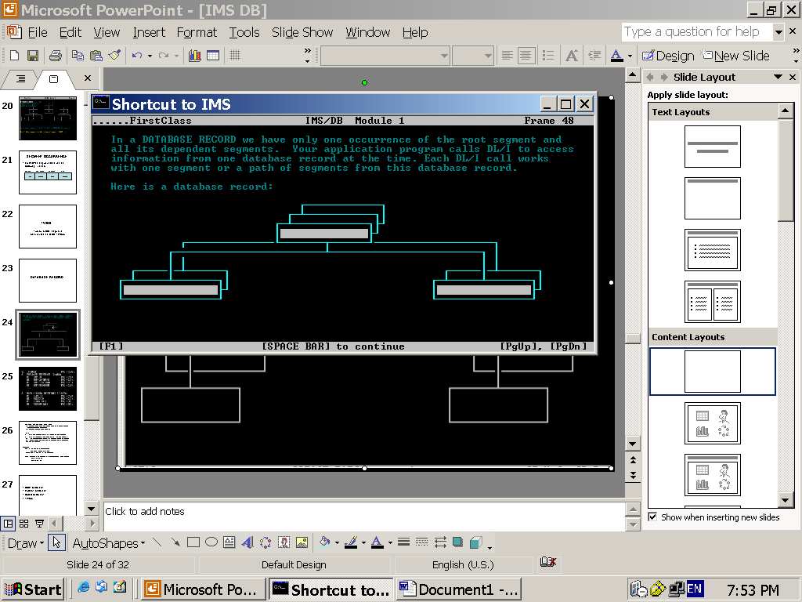
How many DB records present in the below diagram?

Slide 26
What is the order of access in the database if you keep on doing the sequence retrieval?
TOP TO BOTTOM
FRONT TO BACK
LEFT TO RIGHT

Slide 27
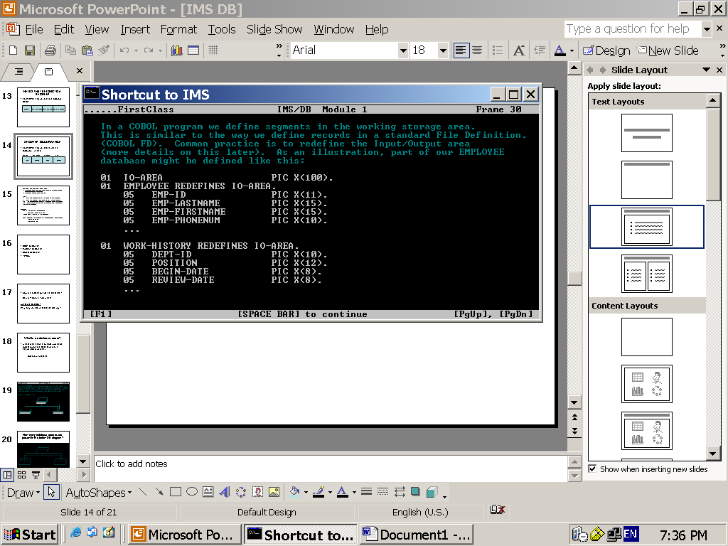
The program interprets segments using pre-defined structures that describe the segment.

Slide 28
What are they?
DATABASE LEVEL
DATABASE POSITION

Slide 29
In any application with the database setup, the following features are common.
The database needs to be defined
Program views of the database needs to be defined
A language (like SQL) / API needs to be there to talk to the DB
Application programs can Insert, Update, Delete and Access the DB data through the language / API.
Conditions can be specified for the intended DB operation such as a WHERE clause in SQL.
An I/O area is defined in the application program for sending and receiving the data to/from database.
A feed back area is defined in the program through which the application program comes to know about the success of the last database operation performed.
After the DB operation is successfully performed, the changes can be made permanent in the database.
If the DB operation is not successful, the changes are to be rolled back.

Slide 30
What are those features in IMS/DB
The database needs to be defined -→ DBD
Program views of the database needs to be defined - PCB and PSB with multiple PCBs
A language (like SQL) / API needs to be there to talk to the DB → DL/I
Application programs can Insert, Update, Delete and Access the DB data through the language / API. → Through calling program ‘CBLTDLI’
Conditions can be specified for the intended DB operation such as a WHERE clause in SQL. -→ SSA (Segment Search Arguments)
An I/O area is defined in the application program for sending and receiving the data to/from database.→ COBOL structure which defines the layout of the segments used.
A feed back area is defined in the program through which the application program comes to know about the success of the last database operation performed. → PCB MASK, a COBOL variable structure
After the DB operation is successfully performed, the changes can be made permanent in the database → Thru STATUS-CODE field in the PCB Mask.
If the DB operation is not successful, the changes are to be rolled back→.

Slide 31
Don’t confuse between
PCB and
PCB-Mask!!

Slide 32
Physical Database and
DBD
(Data Base Description)

Slide 33
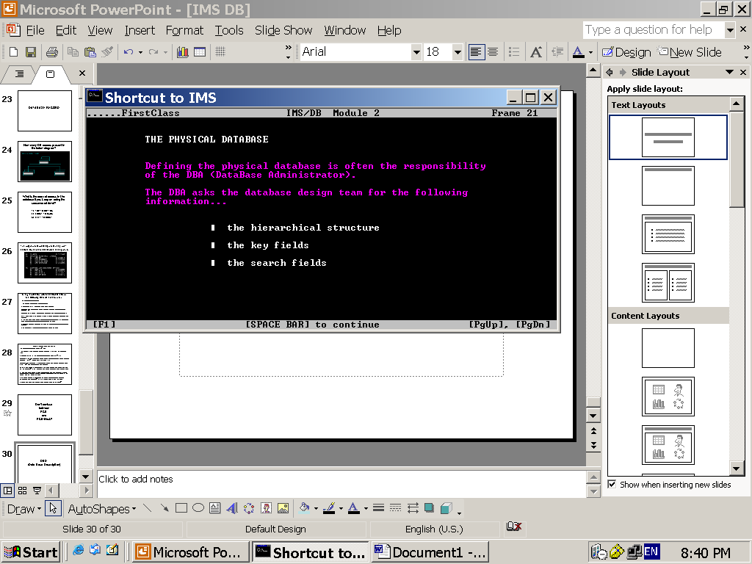

Slide 34
After getting the above info, DBA writes DBD (a separate Macros like language) which describes the entire database. This means, the DBD should clearly define the ROOT, PARENT, CHILD segments, the KEY and SEARCH fields of the segments etc.
After that the DBD macro is GENerated using a process called DBDGEN which produces a “LOAD MODULE”.
This Load Module of DBD is stored in a PDS. This PDS is generally referred to as DBD lib.
Example: MYAPPID.DBD.LIB(DBDNAME)

Slide 35
Normally, the application programmer will be not be coding the DBDs.
But, it is very much required to know how-to read the DBDs if you want to analyze the impact of a change.

Slide 36
How does a DBD look-like?

Slide 37
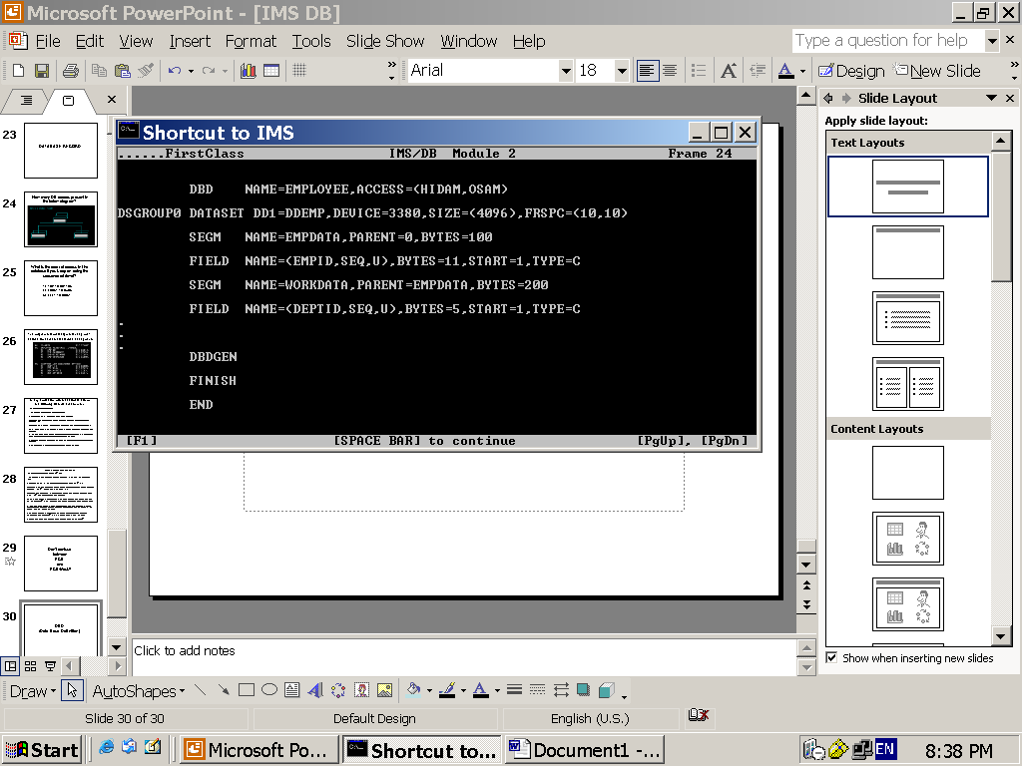

Slide 38
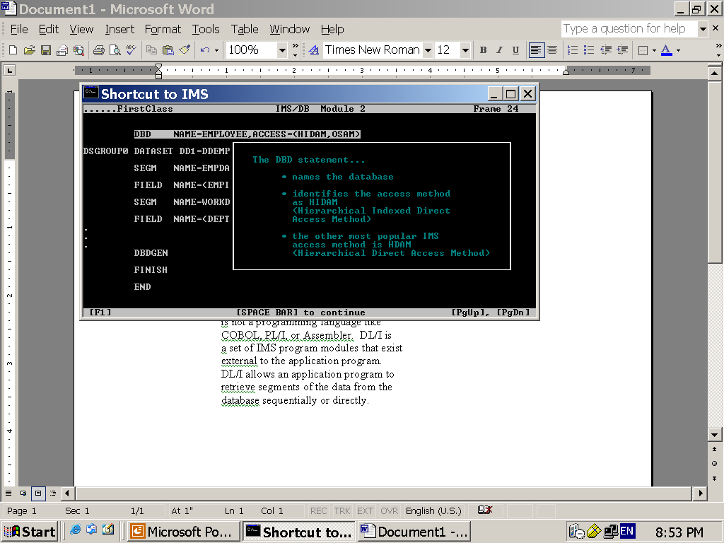

Slide 39
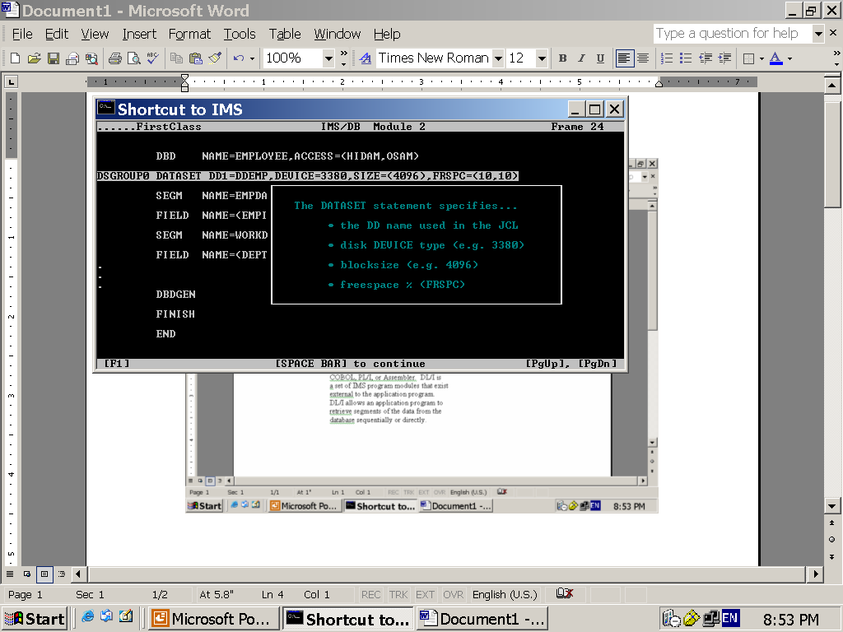

Slide 40
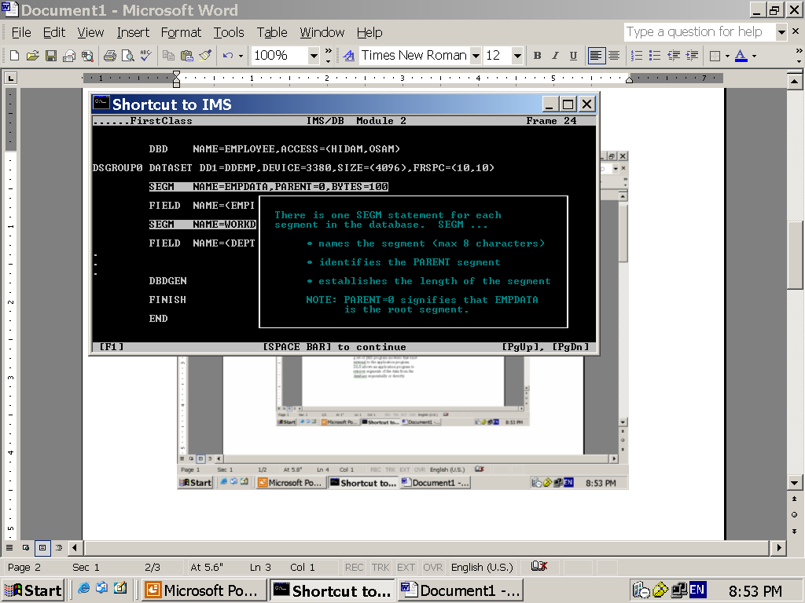

Slide 41
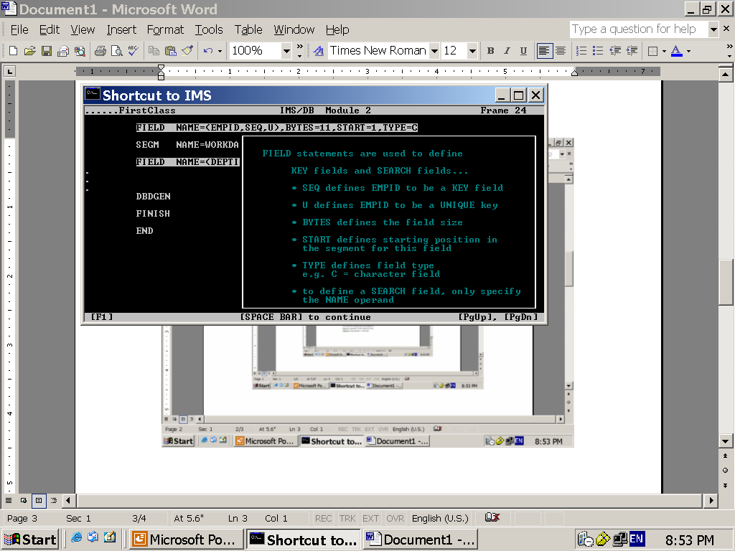

Slide 42
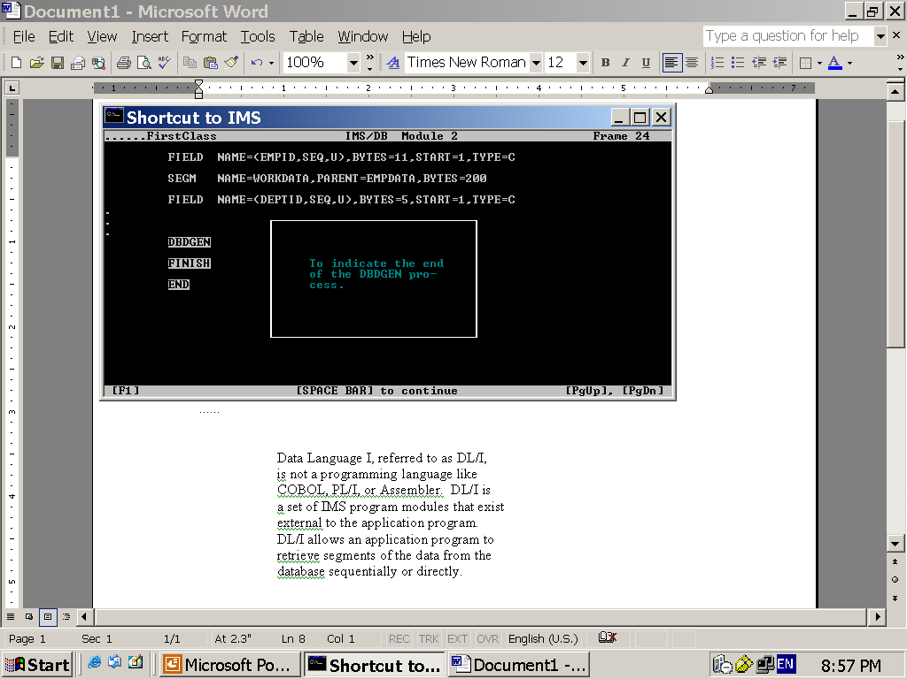

Slide 43
LOGICAL DATABASE

Slide 44
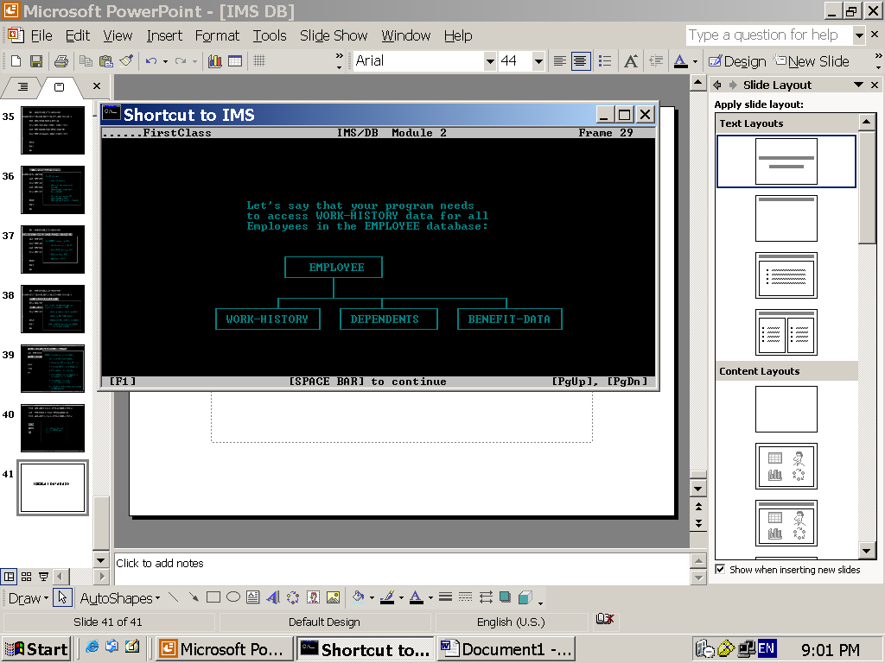

Slide 45
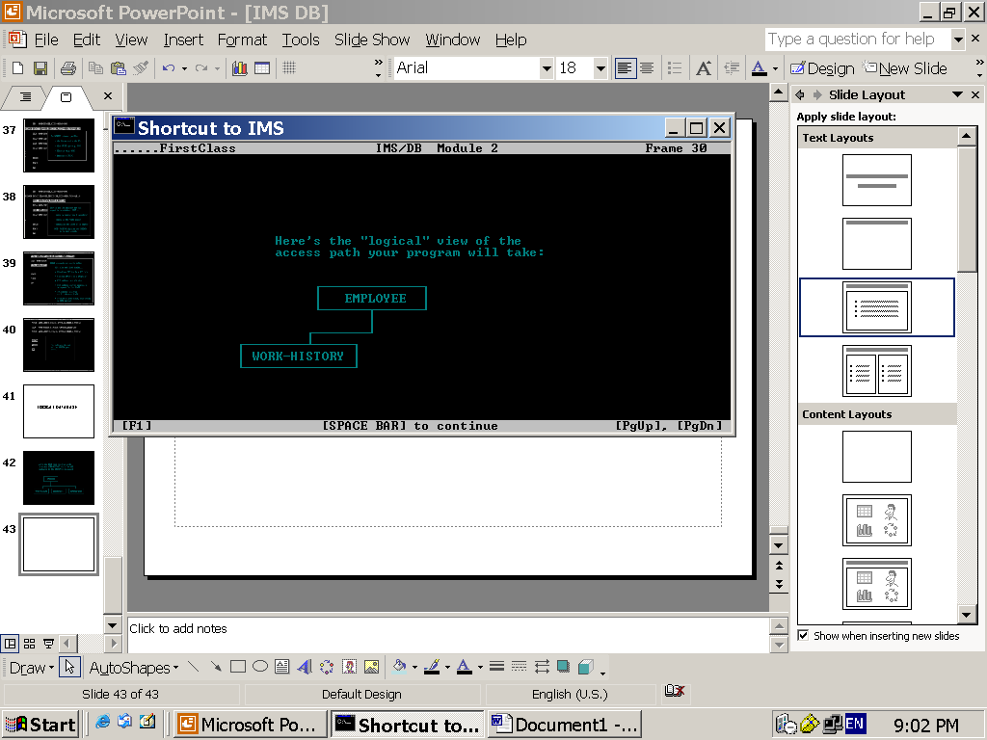

Slide 46
In IMS, the logical database that the program accesses is called PSB.
PSB stands for Program Specification Block.

Slide 47
How the Logical Database is created?
First, the design team (analysts and programmers) decides what logical data structure is required by each program….
…based on that PSB is written, which in a way looks like DBD.
PSB can consist of one or more PCB.
PCB stands for Program Communication Block.
PCB is created for each database.
Each PCB in the PSB describes which are all the segments and fields the program is allowed and what kind of access is allowed.
Similar to DBDGEN, there is PSBGEN. The load module of the PSBGEN is stored a PDS which is generally referred to as PSBlib.
Example: MYAPPID.PSB.LIB(PSBNAME)

Slide 48
How does a PSB look-like?

Slide 49
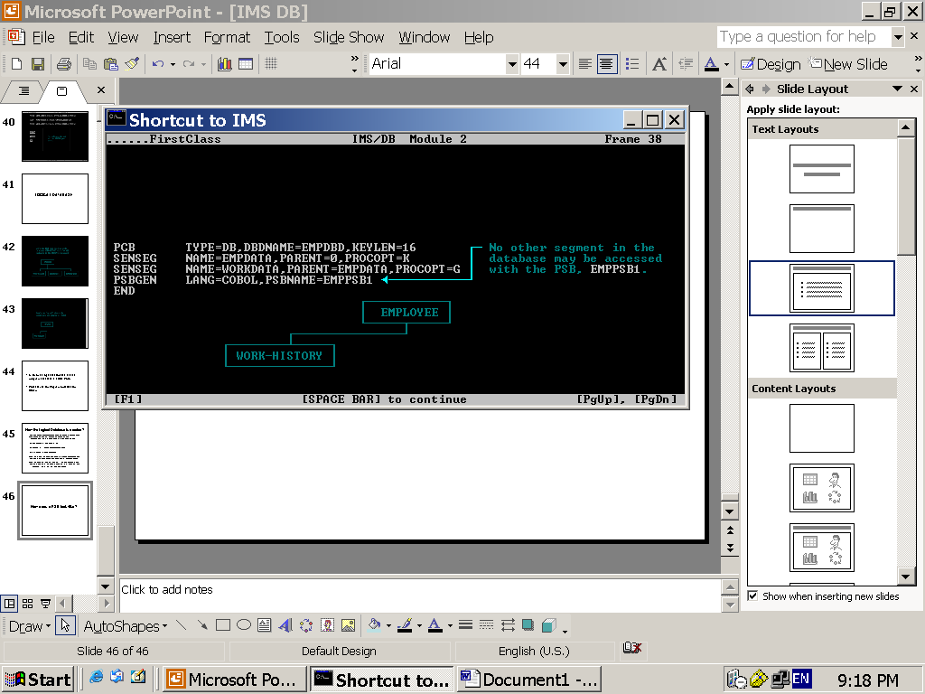

Slide 50
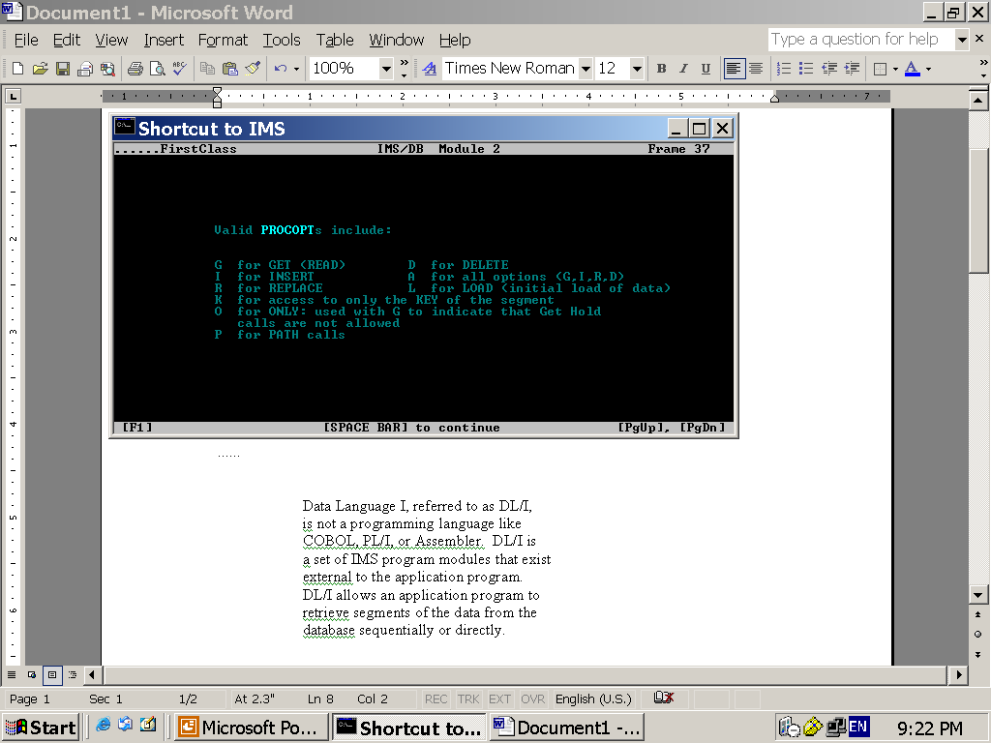

Slide 51
SSA
(Segment Search Argument)

Slide 52
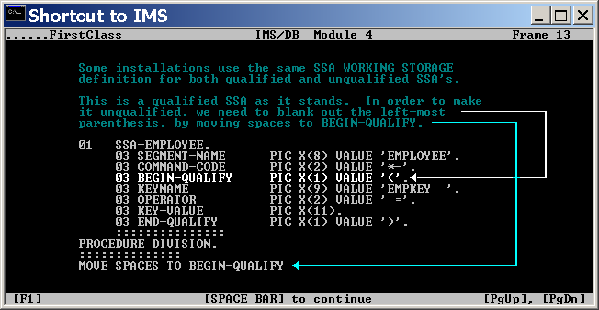

Slide 53
Question:
When Coding an IMS application program, what makes it different from non-IMS program?
Answer:
The major difference lies in where the
IMS components are coded in the application program. What are they?

Slide 54
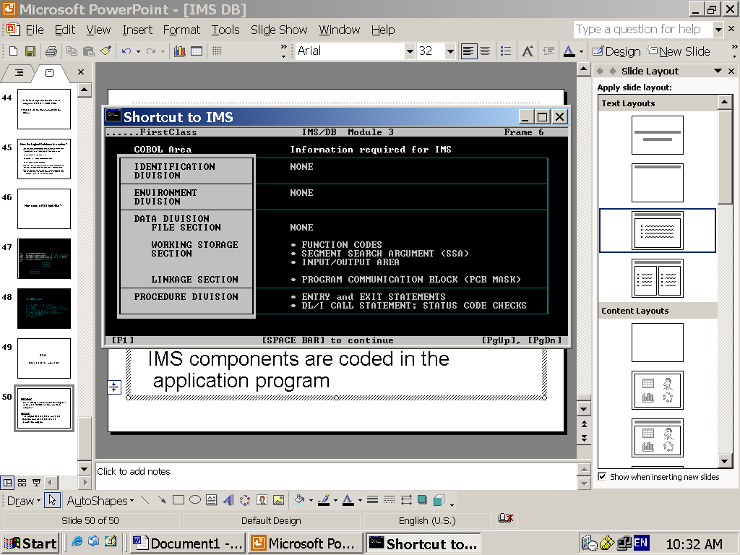

Slide 55
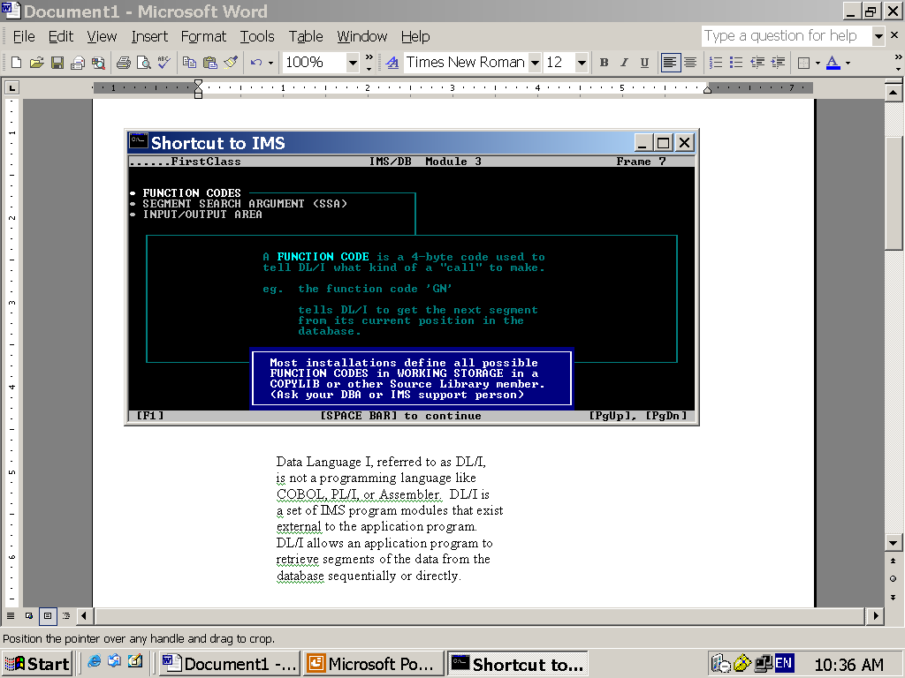

Slide 56
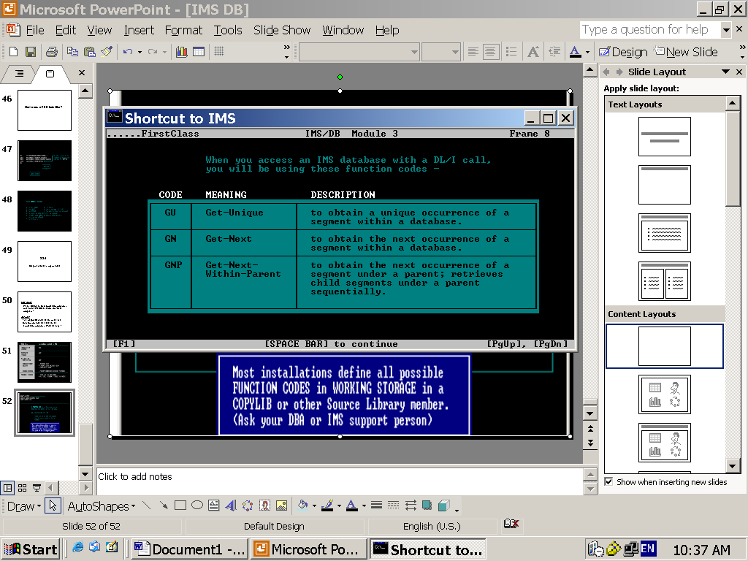

Slide 57
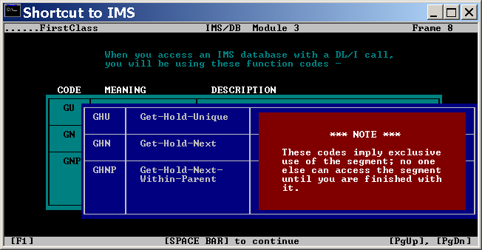

Slide 58
Remember….!!!
In order to REPLACE and DELETE a segment occurrence you must fist issue one of the GET-HOLD functions. Otherwise, the Replace or Delete action will not be successful.
After a successful Get-Hold call, you can issue
  Function code “REPL” to replace an occurrence
  Function code “DLET” to delete an occurrence

Slide 59
Note
Sometimes, a GET-HOLD call is issued before ISRT. But why?
This is to see if the segment occurrence already exists. But this is not always necessary.

Slide 60
SSA (Segment Search Argument)
The COBOL to DL/I calls (CBLTDLI) intend to retrieve, update etc..
Through SSAs, we can provide conditional retrieval or update.

Slide 61
SSA-s contain what?
SSAs contain the Name of the segment that you want
Conditional selection based on key and field value(s)
Command Codes for specifying more selection criteria

Slide 62
Types of SSAs.
There are 2 types of SSAs.
1) Qualified SSA
2) Un-Qualified SSA

Slide 63
INPUT / OUTPUT AREA
The Input/Output area (I/O Area) is a standard record description that describes the layout of the segment being accessed.
During Get operations it holds the retrieved data from a segment occurrence
During ISRT/REPL operations it holds the data to be applied on a particular segment occurrence.

Slide 64
What is a PCB Mask?

Slide 65
PCB Mask
PCB Mask is an area common to your COBOL IMS application program and DL/I.
It is used to transfer information about each call made to DL/I back to the program.

Slide 66
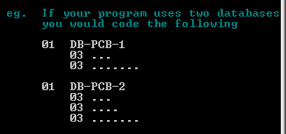
How many PCB masks are to be coded in a program?
You must code one Database PCB Mask for each database your program will access.

Slide 67
Where to code PCB masks in the application program?
Since DL/I passes values to the application program, the PCB Masks should be coded in the Linkage Section.

Slide 68
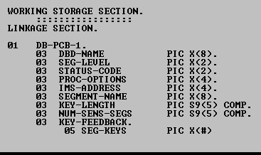
How does a PCB mask look-like?

Slide 69
ENTRY STATEMENT

Slide 70
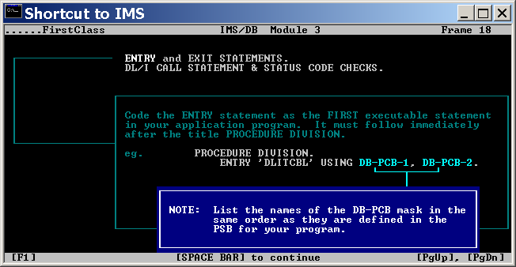

Slide 71
EXIT Statement.
There are 2 kinds of exit statements in COBOL.
  STOP RUN
  GO BACK
  Since your program is a sub-program to IMS, always code GO BACK exit statement.
  Never code STOP RUN..!

Slide 72
Call from COBOL to DL/I
Application programs access segments thru call to DL/I
DL/I interprets the requirements based on the request action, SSA etc. and then satisfies those requests.

Slide 73
IMPORTANT…REMEMBER..!
Standard format of a COBOL to DLI call:
CALL ‘CBLTDLI’ USING FUNCTION-CODE
PCB
IO-AREA
SSA-1
SSA-2
…………

Slide 74
Always use Qualified SSA with GU call.
Question
What happens if you issue a GU call without SSA?

Slide 75
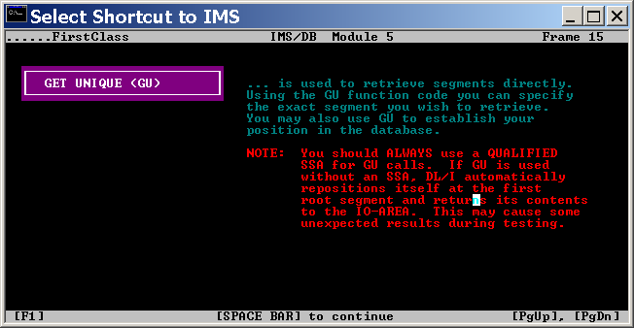
GET UNIQUE (GU) Function.

Slide 76
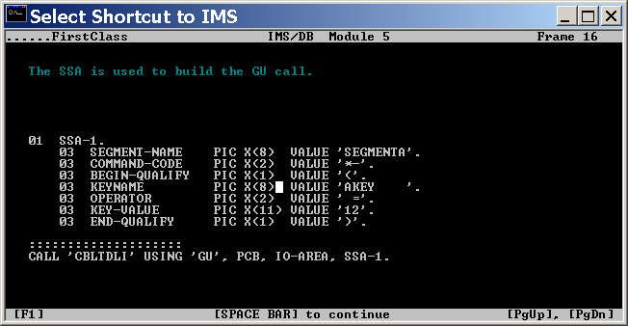
Example of GET UNIQUE

Slide 77
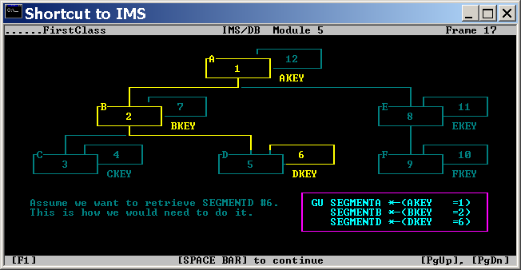
How to GET UNIQUE segment occurrence at level 3?

Slide 78
Your GU call will have 3 SSA-s, one for each level .. !

Slide 79
GET NEXT (GN) Function
GET NEXT is used to sequentially access segments in the database.
DL/I used current position set up by the previous call as a starting point to access next segment occurrences.
With GN function, we can use
  No SSA
  Unqualified SSA
  Qualified SSA

Slide 80
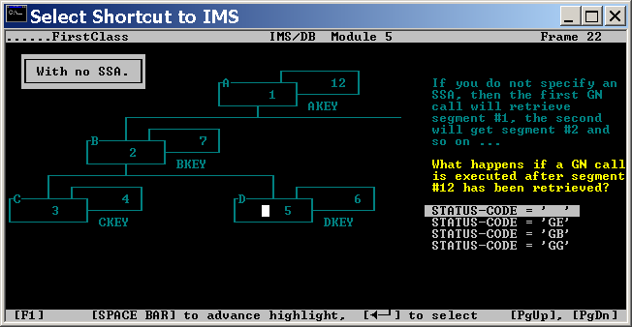
Sequence retrieval using GN with no SSA
(The numbers show the order of retrieval)

Slide 81
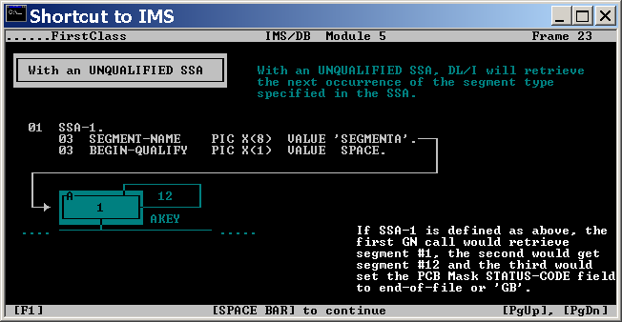
Sequence retrieval using GN with Unqualified SSA

Slide 82
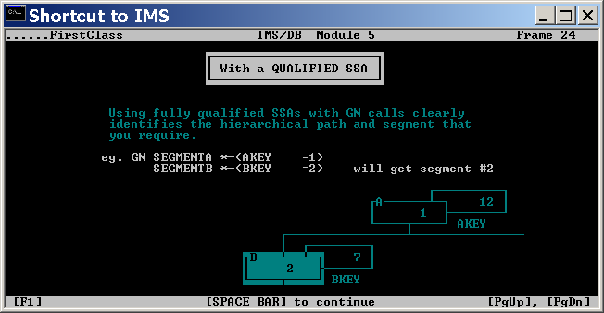
Sequence retrieval using GN with Qualified SSA

Slide 83
Get Next within Parent (GNP) Function
Get Next within Parent (GNP) is used to sequentially access “ONLY” the dependent segment occurrences of the established parentage.
Parentage can be established in 2 ways:
  By a GU or GN call.
  By using Command Code P with GU, GN and GNP calls

Slide 84
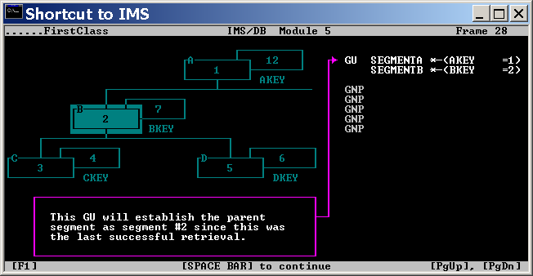
Example: What happens during the below sequence of GNP calls?

Slide 85
1) What is a path?
2) So far we have seen the retrievals of a particular segment occurrence. How to retrieve segment occurrences in a path?
- Using “D” Command Code
3) What is the pre-requisite for making path calls in a program?
- An additional PROCOPT value
(P for path retrieval) needs to be specified in the PSB.

Slide 86
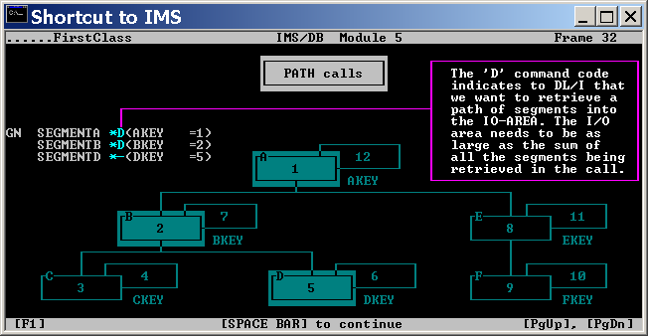
Example

Slide 87
REPLace Function Calls
There are 3 Get-Hold calls which are
  GHU – Get Hold Unique
  GHN – Get Hold Next
  GHNP – Get Hold Next within Parent
  Once your application program successfully Gets Hold of a segment occurrence using any one of the above Get Hold calls then that segment can be replaced.

Slide 88
Remember that GH calls not only Gets Hold of the segment occurrence but also retrieves the data.

Slide 89
How long a HOLD is kept?
It is very much required that after you issue a HOLD, you immediately issue a REPLACE or DELETE.
How long the “HOLD” is kept?
The “HOLD” is released next time when a CBLTDLI call is made using the same PCB mask. So, after the HOLD if the next CBLTDLI call is not Insert or Replace, the hold will be released.

Slide 90
How to change (REPL) the key field of a Segment?
--Through INSERT and DELETE

Slide 91
Normally, SSAs are not used with REPL calls.
There is an Exception though……!!!!
  Using the combination of Command Codes D and “N” with GHU and REPL calls respectively.

Slide 92
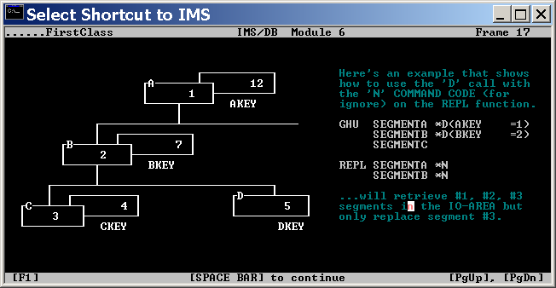
Example

Slide 93
ISRT function
Insert function can be used to INITIALLY LOAD the database as well as insert new segment occurrences.
Thus, ISRT function is used in 2 modes.
  LOAD mode
  INSERT mode

Slide 94
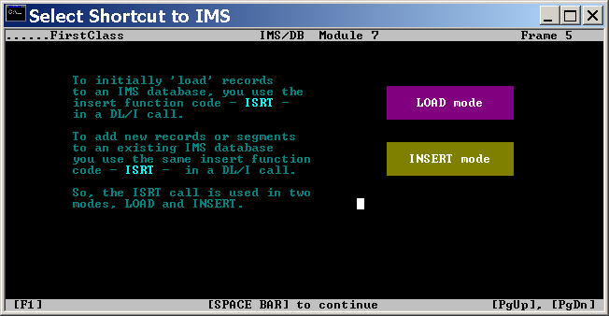
ISRT function

Slide 95
How the differentiation is made from LOAD mode to INSERT mode?
By means of specifying different PROCOPT in PSB, the differentiation is made.
LOAD MODE PROCOPTs :- LS and L
  LS stands for Load Sequentially in ascending order based on Key
  L means the load need not be sequential and should be as per the DBD option
INSERT MODE PROCOPTs :- IS and I
  IS stands for Insert Sequentially in ascending order based on Key
  I means the Insert need not be sequential and should be as per the DBD option

Slide 96
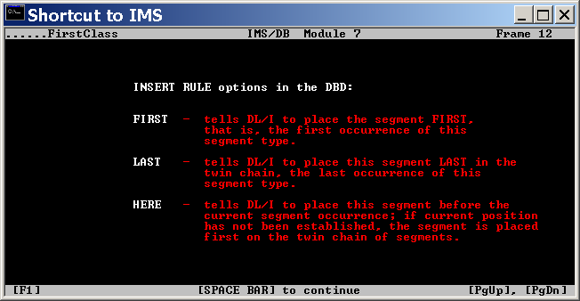
What are the Insert DBD options?

Slide 97
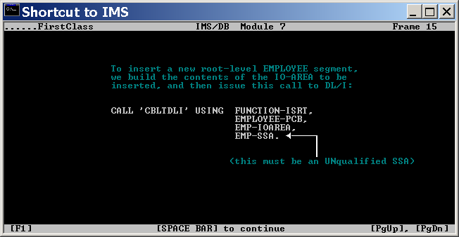
Example of an Insert statement

Slide 98
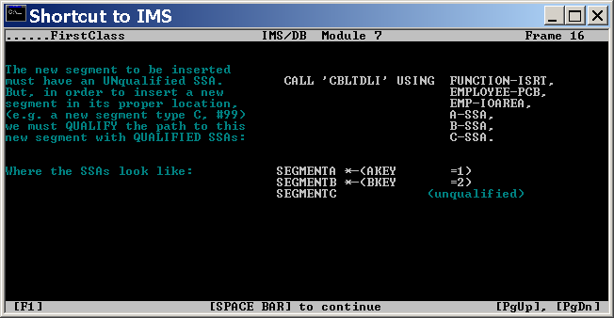
Insert using a Path call

Slide 99
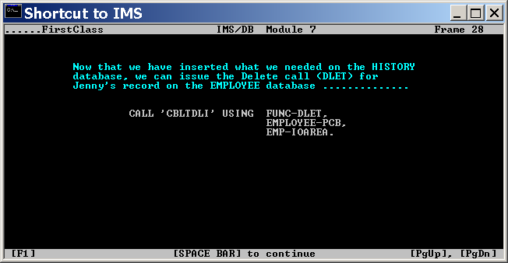
DELET Example

Slide 100
COMPILE / LINK-EDIT Considerations.
IMS supplies an Interface module called DFSLI000 which must be link-edited to your COBOL-IMS batch program.

Slide 101
REMEMBER
Your COBOL program is a sub-program to the IMS.
So, during execution, you will be executing the IMS program DFSRRC00 which is, which in-turn makes call to your COBOL program specified as parameter to the executing IMS program.

Slide 102
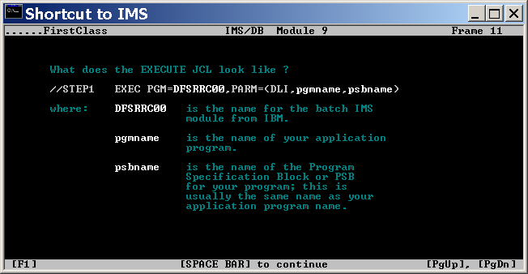
Execute JCL for a COBOL IMS program

Slide 103
ACB
To support the single execution of an application program and its data access, at run time, IMS uses DBDs and PSB to build something called as ACCESS CONTROL BLOCKS (ACB).
Normally, in an IMS/DB environment, such control blocks are built just prior to the execution of an application program. They are used during the program execution and discarded after the execution. This means, every time ACBs are built and then discarded.
There is a way in which, ACBs can be built and stored in libraries called ACB Libs. Thus, each time an application program is executed, a copy of the associated control blocks are retrieved from the ACB library for the usage.
This improves IMS’s efficiency and reduces the time required to build the ACBs because IMS is NOT required dynamically build the control blocks any more.

Slide 104
Thank
You !

